Slide 1
Prejudice
How does it affect the Common Good?

Slide 2
Romans 13: 8 -- 10
Owe no one anything, except to love one another; for the one who loves another has fulfilled the law. The Commandments, “you shall not commit adultery; you shall not murder; you shall not steal; you shall not covet”; and any other commandment, are summed up in this word, “love your neighbor as your self.” Love does no wrong to a neighbor; therefore, love is the fulfilling of the law.

Slide 3
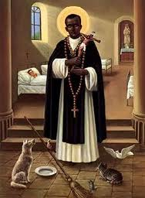
St. Martin De Porres
Born in 1579 in the city of Lima, the illegitimate son of a Spanish nobleman and a black former slave.
Started as a servant.
Cared for poor and sick no matter what their race.
His piety and miraculous cures led his superiors to drop the racial limits, and he was made a full Dominican.
Canonized 1962 by Bl. Pope John XXIII.
He is the patron saint of mixed-race people and all those seeking interracial harmony.

Slide 4
Closing prayer.
Dear gracious God, burn away our prejudice; replace it with your love.
Amen

