Slide 1
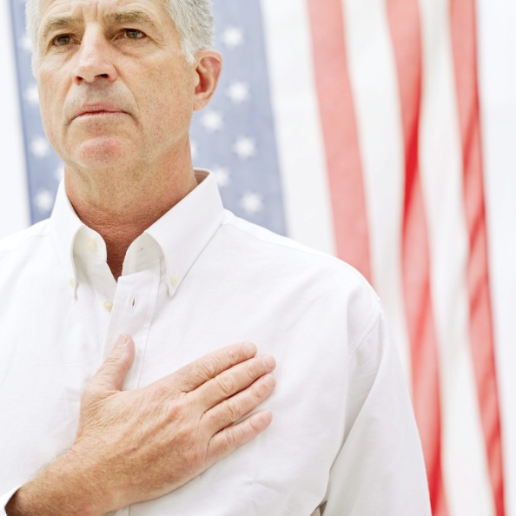
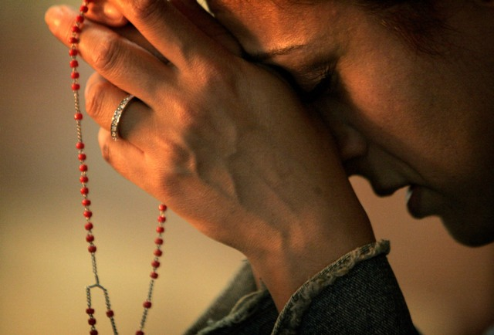
The American Election
A Catholic perspective

Slide 2
The Most Important Thing:
We must think like God thinks not like humans think!
That is our only guide: our conscience i.e.
The Voice of God
We must form our consciences in order to form a more perfect union!

Slide 7
PRAYER FOR OUR COUNTRY
Almighty God, bless our nation and make it true to the ideas of freedom and justice and brotherhood for all who make it great. Guard us from war, from fire and wind, from compromise, fear, confusion. Be close to our president and our statesmen; give them vision and courage, as they ponder decisions affecting peace and the future of the world. Make me more deeply aware of my heritage; realizing not only my rights but also my duties and responsibilities as a citizen. Make this great land and all its people know clearly Your will, that they may fulfill the destiny ordained for us in the salvation of the nations, and the restoring of all things in Christ. Amen

