Slide 1
THE ART OF SOCIAL JUSTICE
Catholic Social Justice Teachings

Slide 2
Justice
Our God is an AWESOME God!
“I believe in God the Father almighty, the creator of heaven and earth”
“Who is like the LORD our God…He raises the needy from the dust, lifts the poor from the ash heap, Seats them with princes…Hallelujah!” (Ps 113)

Slide 3
LOve
Storge
familial love, the bond that exists between someone and persons, animals, and the things around them.
Eros
passion, not only of a sexual nature, but also of an aesthetic or spiritual nature, for what is conceived of as supremely beautiful and desirable.
Philia
pertains to friends, freely chosen because of mutual compatibility and common values.
Agape
manifested when one person gives to another more needy. It is generous selflessnes without concern for reward.

Slide 4
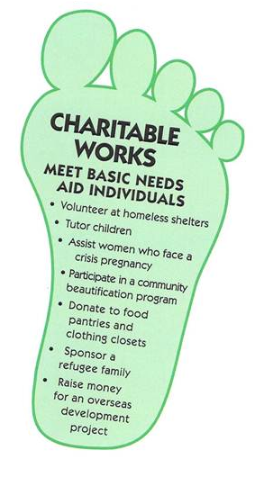
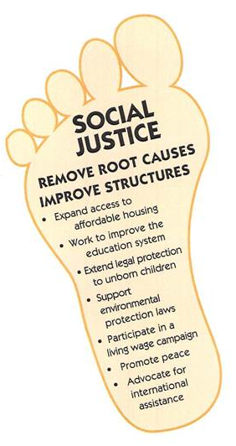
Recall: The Two Feet of Catholic social Justice
ACTION:
REFLECTION:
TRANSFORMATION:

Slide 5
ACTION
Jn 21: “Simon, son of John, do you love me more than these?” He said to him, “Yes, Lord, you know that I love you.” He said to him, “Feed my lambs.”…when you were younger, you used to dress yourself and go where you wanted; but when you grow old, you will stretch out your hands, and someone else will dress you and lead you where you do not want to go.”
Mt 22: “Teacher, which commandment in the law is the greatest?”…“You shall love the Lord, your God, with all your heart, with all your soul, and with all your mind. This is the greatest and the first commandment. The second is like it:* You shall love your neighbor as yourself.”
Lk 6: “Give and gifts will be given to you; a good measure, packed together, shaken down, and overflowing, will be poured into your lap. For the measure with which you measure will in return be measured out to you."

Slide 6
ACTION
The initial response to issues of human concern is to act to meet the immediate need:
we feed the hungry
shelter the homeless
resettle the refugee
protect the victims of domestic violence
recycle paper and other products
But this type of action alone also frustrates us. It does address the pain of people and the planet, but it does little to address its causes. People continue to come to us hungry, homeless, in flight from war and oppression, and battered. The environment continues to suffer.

Slide 7
REFLECTION
Lk 6: “In those days he departed to the mountain to pray, and he spent the night in prayer to God. When day came, he called his disciples to himself, and from them he chose Twelve”
Mk 1: “He cured many who were sick with various diseases, and he drove out many demons, not permitting them to speak because they knew him. Rising very early before dawn, he left and went off to a deserted place, where he prayed.”
Lk 11: “He was praying in a certain place, and when he had finished, one of his disciples said to him, ‘Lord, teach us to pray just as John taught his disciples.’ When you pray, say: Father, hallowed be your name, your kingdom come…’”
Examination of Conscience!

Slide 8
REFLECTION
The next step is to ask why!
Why are people hungry, homeless, uprooted, battered, or discriminated?
Why is the environment damaged?
What factors contribute to this social problem?
Who gains from the current situation? Who loses?
Who has power? Who doesn't?
Which beliefs and values support the status quo? And which challenge it?
What does our faith have to say about social issues and their causes?
What does Scripture and Catholic social teaching have to say?
The reflect phase of the ART process enables us to explore the underlying causes of poverty, violence, homelessness, racism, war, ecological devastation, and other issues. It also' gives us the opportunity to reflect on the rich tradition of papal, conciliar, and episcopal teaching.

Slide 9
Transformation
The final step is to transform the social structures that contribute to suffering and injustice.
Social transformation is a different kind of action. Transformation gets at root causes; it does not stop at alleviating symptoms. We can transform our communities and our world through:
changing social values,
empowering low-income people,
advocating for just public policies,
buying or boycotting goods based on social values,
adopting lifestyle changes,
investing in socially responsible corporations
“Action on behalf of justice and participation in the transformation of the world fully appear to us as a constitutive dimension of the preaching of the Gospel, or, in other words, of the Church’s mission for the redemption of the human race and its liberation from every oppressive situation” (World Synod of Bishops, Justice in the World)

Slide 10
What’s your excuse?

