Slide 1
Welcome!
Catholic Social Justice

Slide 2
St. Teresa of Calcutta

Slide 3
St. peter claver, sj

Slide 4
Edith Stein St. Teresa benedicta

Slide 5
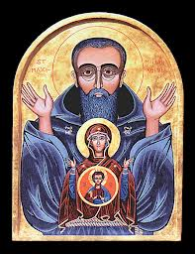
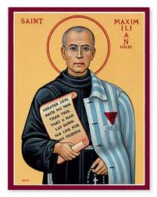
st. maximilian kolbe
He was canonized by the Catholic Church as Saint Maximilian Kolbe on October 10, 1982 by Pope John Paul II, and declared a “Martyr of Charity.”
He is the patron saint of drug addicts, political prisoners, families, journalists, prisoners and the pro-life movement. Pope John Paul II declared him the “The Patron Saint of Our Difficult Century”.
“See then, brother, the tremendous honor of the position that God in his kindness has placed us in. Through obedience we transcend our own limitations and align ourselves with God’s will, which, with infinite wisdom and prudence, guides us to do what is best. Moreover, as we become filled with the divine will, which no created thing can resist, so we become stronger than all others.”

Slide 6
Justice?
During the Second World War he provided shelter to refugees from Greater Poland, including 2,000 Jews whom he hid from Nazi persecution in his friary.
He was active as a radio amateur, vilifying Nazi activities through his reports. He was sent to Auschwitz.
In July 1941 a man from Kolbe’s barracks vanished, and 10 men from the same barracks were chosen to be starved to death. (The man who had disappeared was later found drowned in the camp latrine.)
Franciszek Gajowniczek, arrested for also helping Jews, cried out, lamenting his family; Kolbe volunteered to take his place.
During the time in the cell he led the men in songs and prayer. After three weeks of dehydration and starvation, only Kolbe and three others were still alive. Finally, as the last alive, he was murdered with an injection of carbolic acid.

Slide 7
Two Feet of Catholic social Justice

Slide 8
Two feet, Justice.
“Because God’s glory shines through most brightly in the salvation of the souls that Christ redeemed with his own blood, let it be the chief concern of the apostolic life to bring salvation and an increase in holiness to as many souls as possible. Let me briefly outline the best way to achieve this end – both for the glory of God and for the sanctification of the greatest number.”
Kolbe gave his life to address the causes of injustice.
Gajowniczek, the man he saved and his family, were at his Canonization.

